Slide 1



TEAM NAME:
JARVIS

Slide 2
Problem Statement
ServiceNow Chatbot

Slide 3
Describe your solution
Service now Chat bot will help you create INC on the go
and redirect user with FAQs at single point only.
Technology Stack used
IBM Cloud
IBM Watson Assistant
JavaScript
JSON
HTML

Slide 4
Use Cases & Business Value of the solution
Earlier users needs to follow some procedure to create SNOW tickets as:
Users need to contact support to create SNOW ticket for there issue
Need to go through all required fields to raise tickets
Business Value :
User friendly
Cost Effective
Reduces User efforts

Slide 5
What was accomplished
SNOW tickets are created in behalf of user with minimum efforts.
SNOW ticket are assigned to specified team
User can go through company’s details like contact details, product
pricing, etc in single window.

Slide 6
Challenges & Learnings
Working on IBM cloud as a new user with Lite feature was a challenging
task.
Working with Watson Assistant was great learning for us as well as
for Watson.

Slide 7
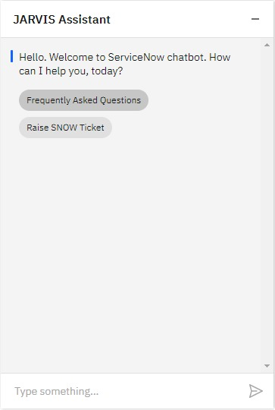
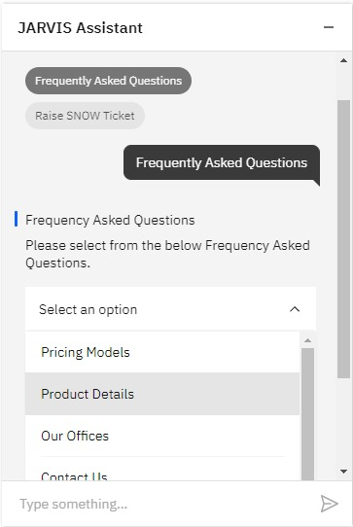
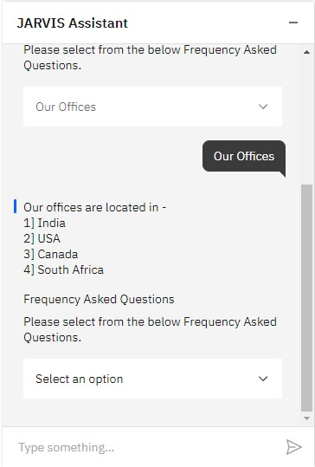
Screenshots (if any applicable)

